Slide 1



FASHION GENERAL
PET ADOPTION

Slide 2


CONTENT
Features of the website and design choices.
01
Challenges faced and how they were addressed.
02
Future improvements or additional features that could be add
03
Github / Deployed Link
04

Slide 3
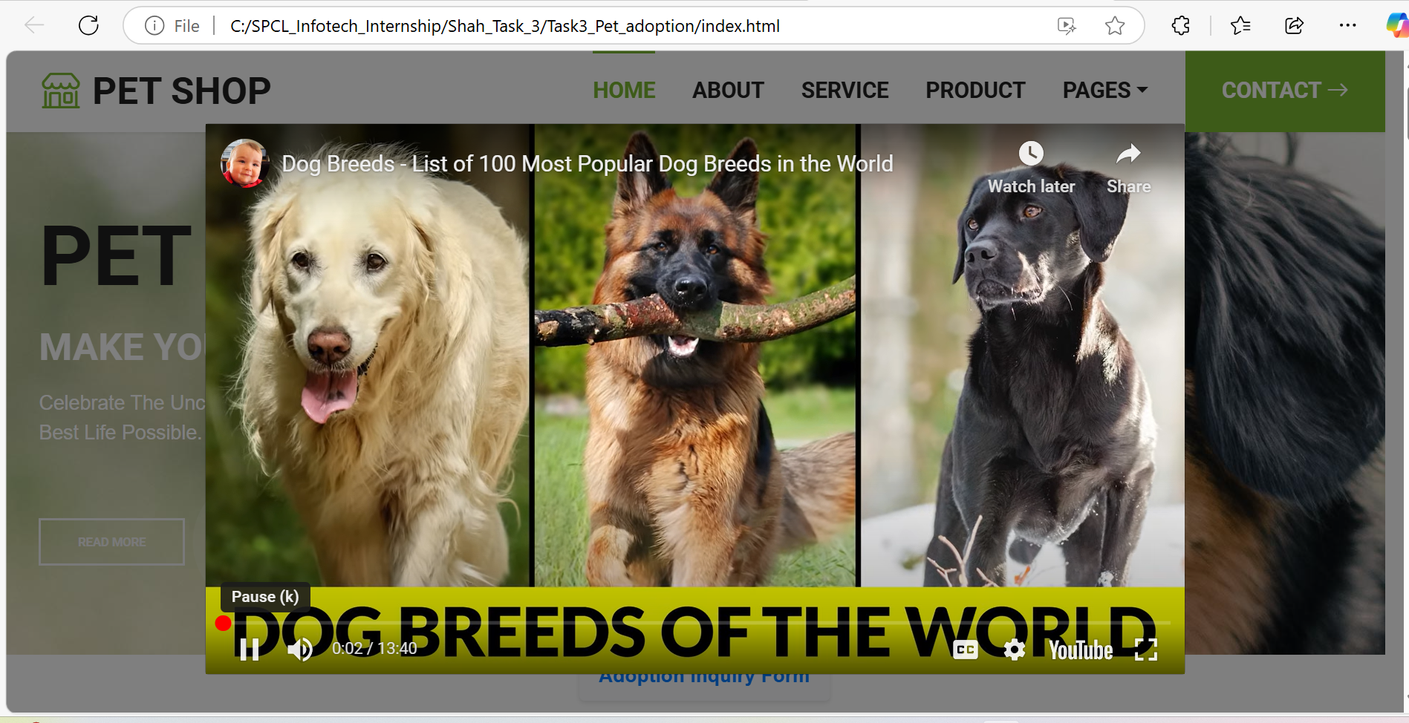

Features of the website and design choices.
Homepage with Attractive Design & Search Bar

Slide 4
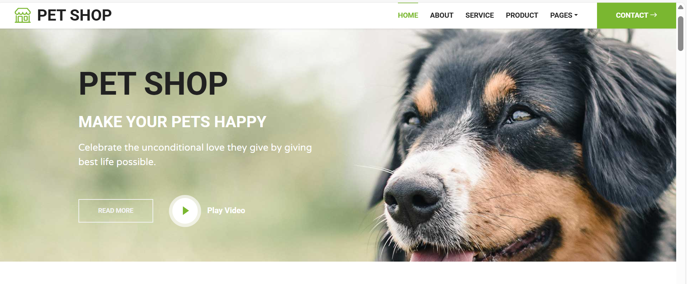
Features of the website and design choices.
Homepage with Attractive Design

Slide 5
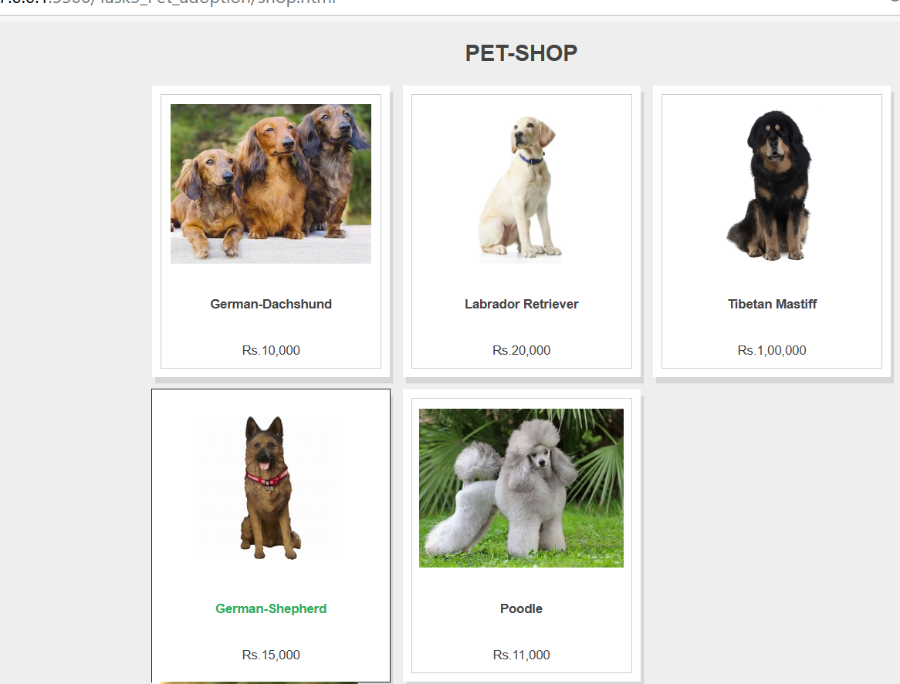
Features of the website and design choices.
Homepage with Attractive Design

Slide 6
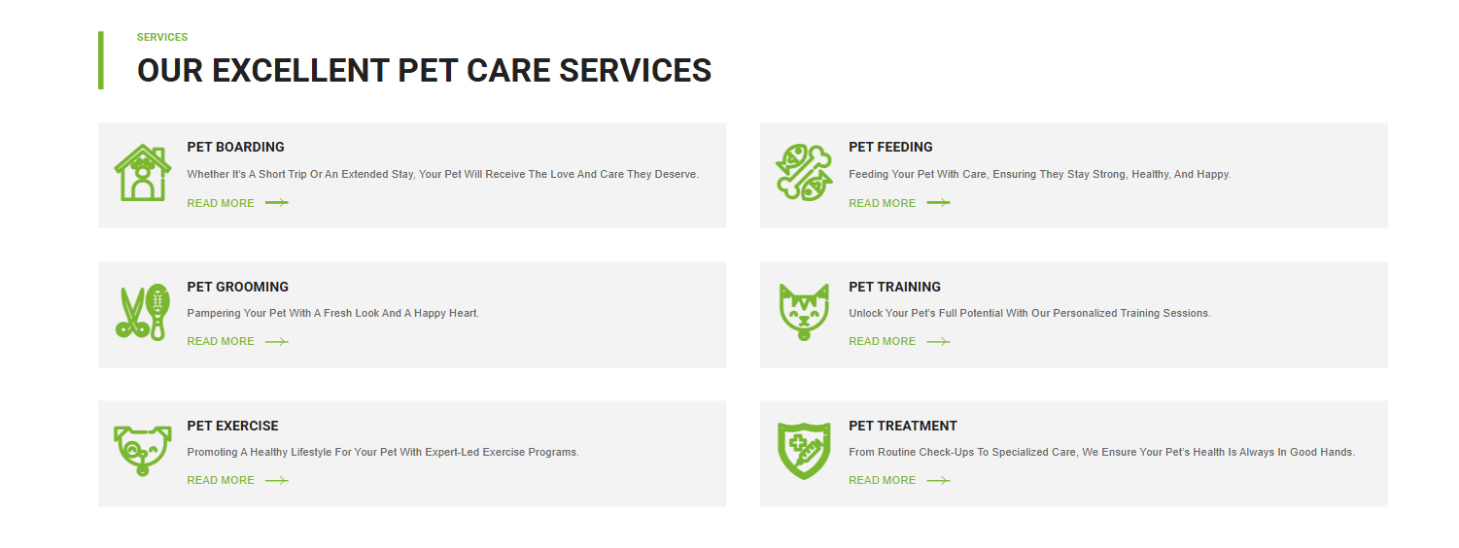
Features of the website and design choices.
Pet Listings with Filters Design Choices

Slide 7
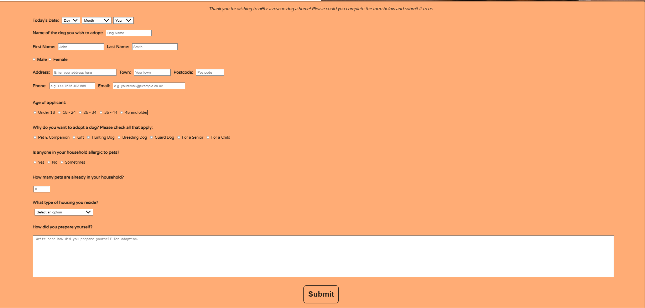
Features of the website and design choices.
Adoption Page

Slide 8
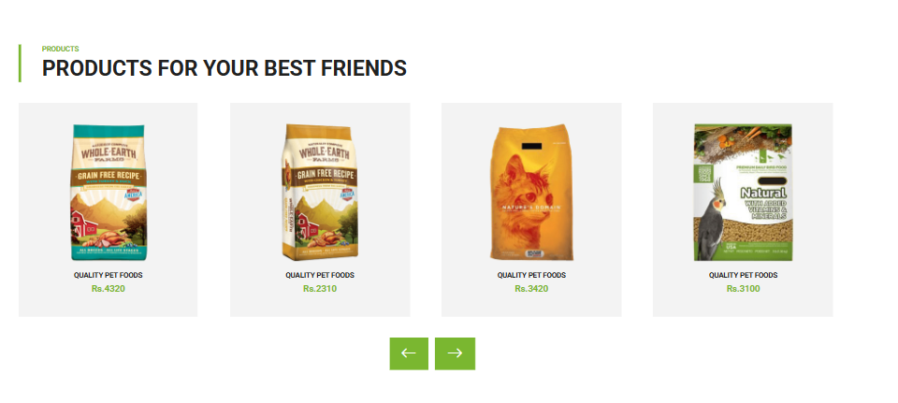
Features of the website and design choices.
Product Functionality

Slide 9
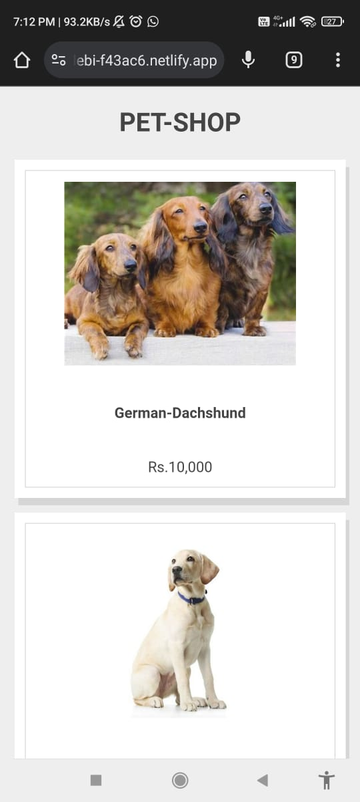
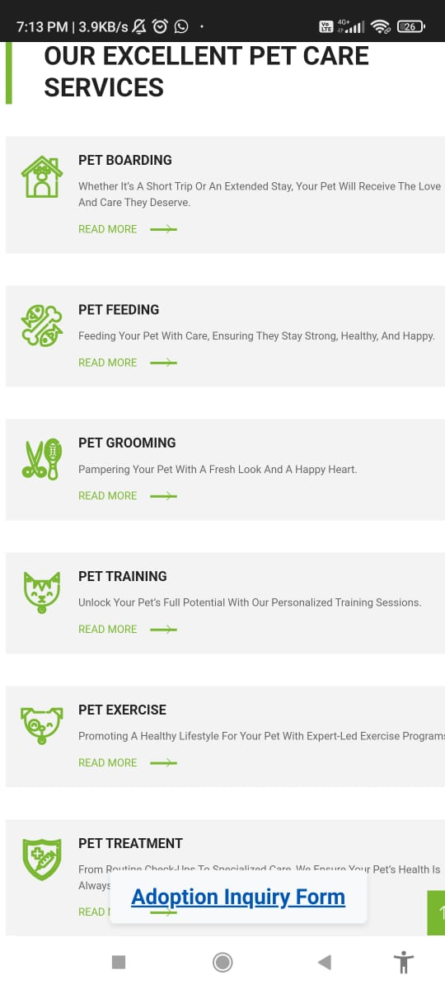
Features of the website and design choices.
Mobile-Responsive Design

Slide 10
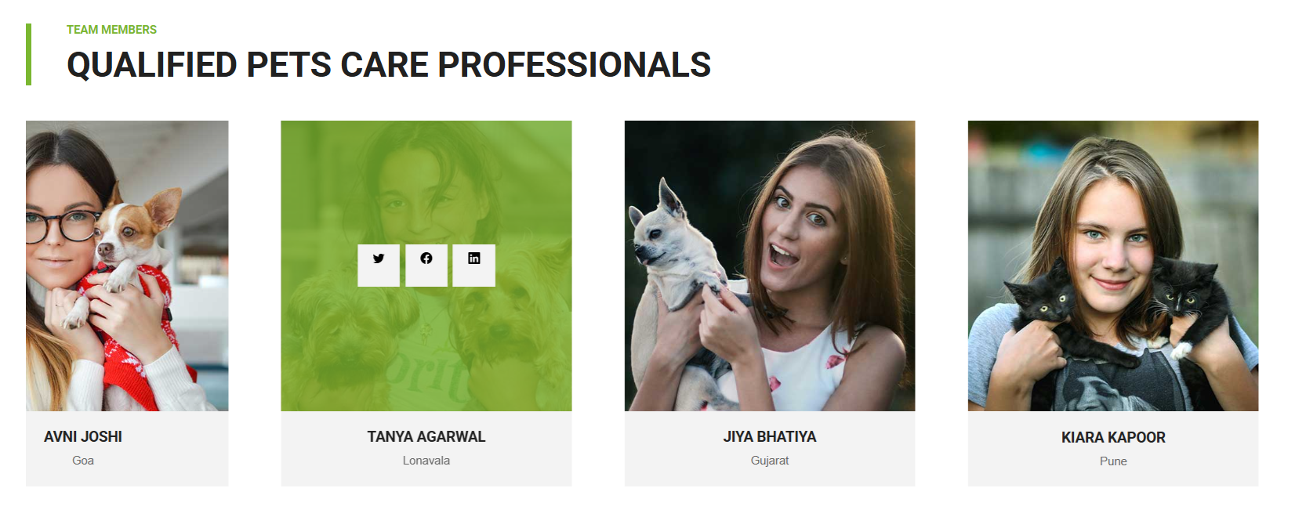
Features of the website and design choices.
Mobile-Responsive Design

Slide 11
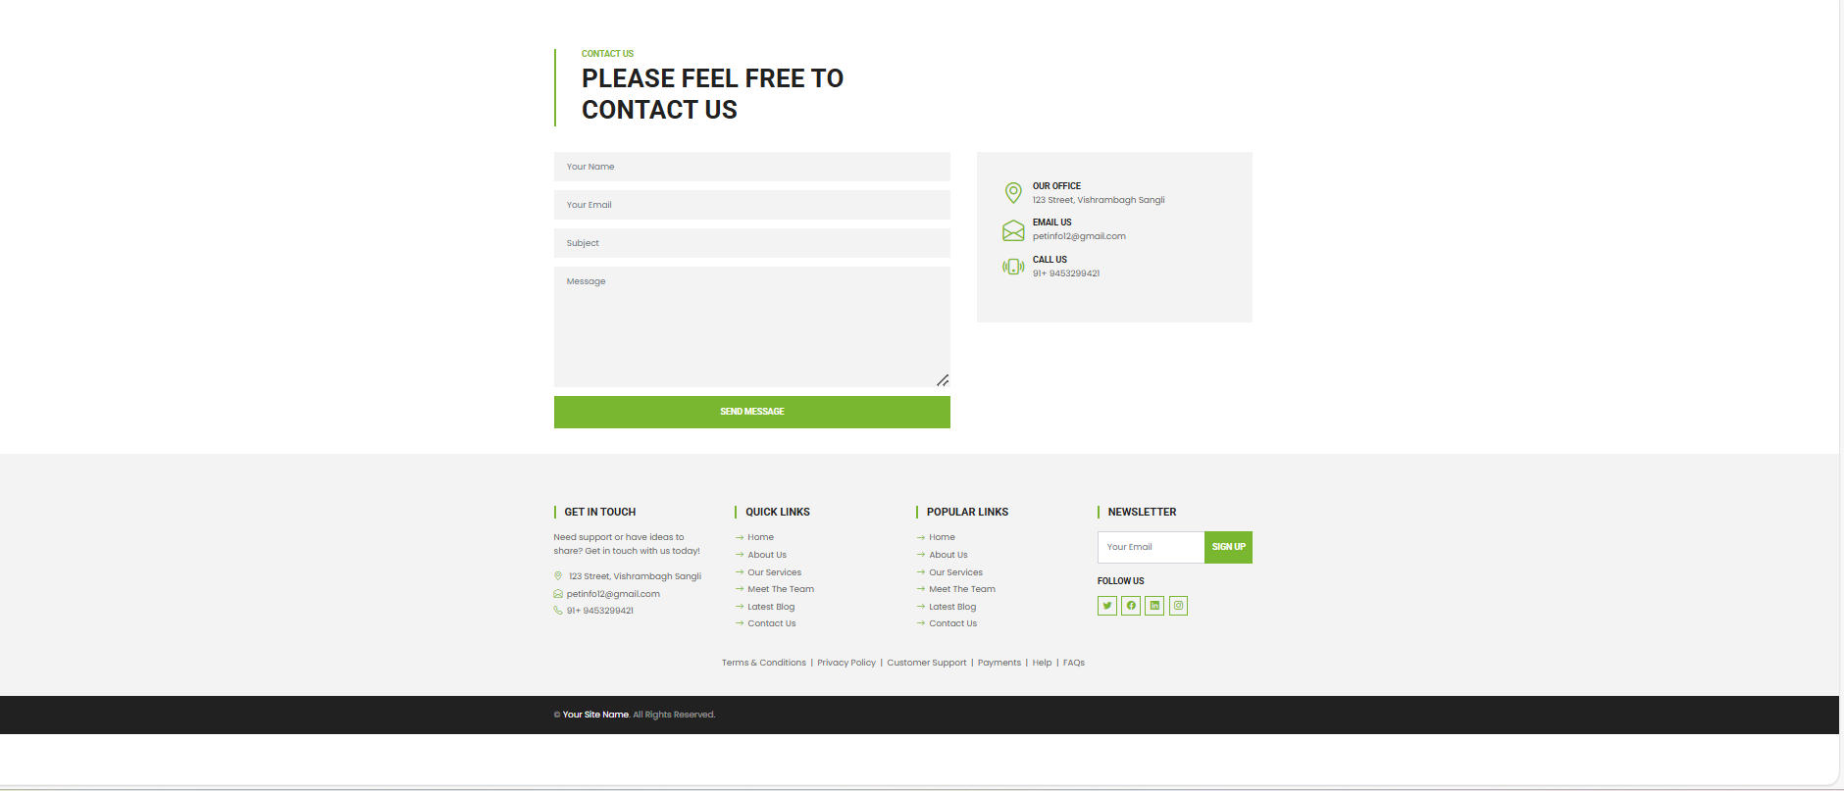
Features of the website and design choices.
Contact Page

Slide 12
Challenges faced and how they were addressed.
oChallenges faced and how they were addressed.
o
Challenges faced and how they were addressed.
30%
25%
20%
15%
Mobile Responsiveness
Dynamic Filtering and Search
Form Validation
Loading Speed
Challenge:- Ensuring the website looks good on all devices.
Solution: Used CSS media queries and flexible layouts (Flexbox/Grid).
Challenge: Implementing real-time filtering of pets.
Solution: Used JavaScript to update results dynamically as users applied filters or typed search queries.
Challenge: Ensuring users submit valid data in forms.
Solution: Implemented real-time validation using JavaScript with feedback for missing or incorrect fields.
Challenge: High-quality images slowing down the site.
Solution: Optimized image sizes and used lazy loading techniques.

Slide 13
Future improvements or additional features that could be added.
1. Advanced Pet Matching Algorithm
2.
Adoption Tracking System
3.
Adoption Tracking System

Slide 14
Future improvements or additional features that could be added.
4.
Pet Health Records
5.
Donation and Sponsorship Features
6.
Community Forum

Slide 15
Future improvements or additional features that could be added.
7.
Gamification Elements
8.
Integration with Maps
6.
Mobile App Development

Slide 16
GITHUB / DEPLOY
LINK
FASHION GENERAL
GITHUB LINK::-
DEPLOY LINK:-

Slide 17
CONCLUSION
FASHION GENERAL
The pet adoption website has been designed with features to simplify the adoption process, provide an engaging user experience, and encourage responsible pet ownership.

Slide 18
FASHION GENERAL
THANKYOU!!!

